Slide 1
Lecture 4: Computation with DFA
Regular Language
Regular Operations
Presented by
Prof. Vaibhav Narayan Chunekar
K. J. Somaiya College off Engineering, Vidyavihar, Mumbai

Slide 2
Computation of DFA
Let M = (Q,∑, 𝛿,q0,F) and
w = a1 a2 a3 a4…………………………………an
where a_{i} ∈ ∑
Then we say that M accepts w if there exist (∃) a sequence of state ro,r1,r2,r3……….rn
Q= set of State➔ {ro,r1,r2,r3……….rn}

Slide 3
Formal way of DFA to Accepts String
For such operation there exist three properties holds:
r₀=q₀ ➔ start State == Initial Condition
r _{i} = ⸹( r _{i -1} - a _{i} ) ➔Transition Condition
r _{n} ∈ F ➔Acceptance Condition
Note: The state r _{i} need not be distinct

Slide 4
Regular Language
DFA accepts this Language
L ⊆ Σ* then we say that M accepts L , if L ={ w ∈ Σ* | M accepts w }
Let L be a language then we say that L is regular Language if there exist
DFA M such that L =L(M)

Slide 5
Example 1 of regular Language
L1={ w | w does not contains 11 as a substring }
➔ Implications for language acceptance /rejections
00
01
10
11

Slide 6
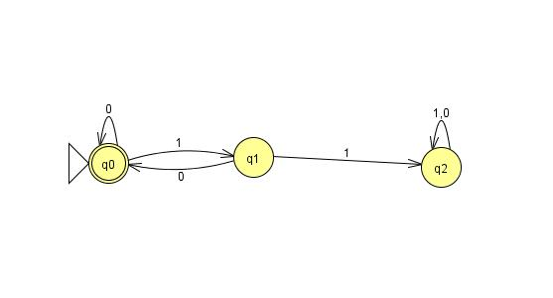
Transition graph for Example 1

Slide 7
Dump state
The state q2 is called Dump State
The dump state is a state from where the automaton cannot reached to Accept State/Final State.
Look previous L and Transition graph:
String ➔0110→ q0,q0,q1,q2,q2➔ Not accept state
String ➔101→ q0,q1,q0,q1➔ accept state
100→ q0,q1,q0,q0➔ accept state

Slide 8
Example 2 of regular Language
L2={ w ∈ Σ* , where Σ={0,1} | | w |=3 }
➔ Implications Language
000
010
100
11
1000

Slide 9
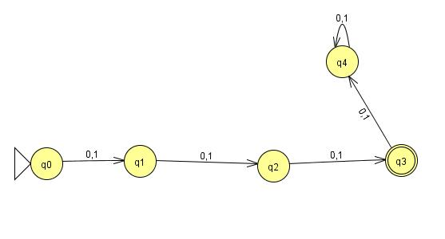
Transition graph for Example 2

Slide 10
Is there any Non Regular Language?
Yes
Example : L={ 0 ^{n} 1 ^{n}| n>=0}
we will learn regarding this during Pumping Lemma.

Slide 11
Regular Operations
The operation that gives another language by using such operation.
Applicable for Binary as well as Unary operator
Binary operator operations: Union and Concatenation
Unary operation: Star operation

Slide 12
Union Operation
Let A, B ⊆ Σ*
A U B= { x = x ∈ A or x=x ∈ B }
Example:
A={ 0,1}
B={ a,b}
Then Union operations will gives you outcome of combining Language as :
L= {0,1,a,b}

Slide 13
Concatenation Operation
A.B = { xy | x ∈ A and y ∈ B }
Example:
A={a,b}
B={1,2,3,……}
A.B= { a.1,b.1,a.2,b.2,………….. }

Slide 14
Star Operations
A*= { x1.x2……..x _{k} | where k>=0 and each xi ∈ A for all i }
Example: A ={10,001}
A*= { ∊, 10,001,1010.10001,00110,………. }

Slide 15
Thanking you…

